Slide 1
Ontario Housing Market Analysis
Part 2
Predicting Ontario real estate data from ETFs,
lumber prices, interest rates, and consumer price index

Slide 2


Meet The Team
Jamie Mellway
Josh Esteban
Majeed Raheem
Joey Falvo
Rafi Nazamodeen

Slide 3
Model #1

Slide 4
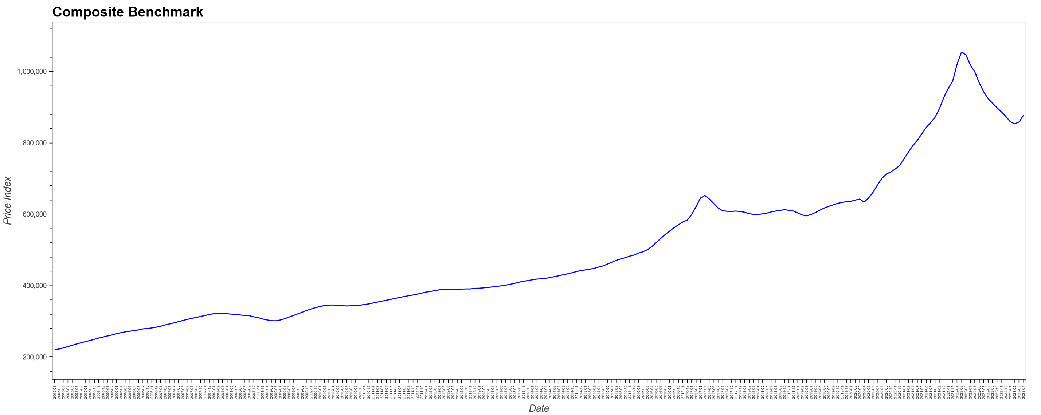
Dependent Variable
CREA – Composite Benchmark for Ontario
https://creastats.crea.ca/en-CA/

Slide 5
Inputs Sources
Macrotrends Lumber Prices - 50 Year Historical Chart
https://www.macrotrends.net/2637/lumber-prices-historical-chart-data
iShares Global Timber & Forestry ETF (WOOD-Q)
https://finance.yahoo.com/quote/WOOD/history?p=WOOD
ta
SPDR S&P Homebuilders ETF (XHB)
https://finance.yahoo.com/quote/XHB/history?p=XHB
iShares U.S. Home Construction ETF (IBT)
https://finance.yahoo.com/quote/ITB/history?p=ITB
Consumer Price Index (CPI)
https://www150.statcan.gc.ca/t1/tbl1/en/tv.action?pid=1810000601&cubeTimeFrame.startMonth=12&cubeTimeFrame.startYear=2005&cubeTimeFrame.endMonth=04&cubeTimeFrame.endYear=2023&referencePeriods=20051201%2C20230401
Interest rates
https://www.bankofcanada.ca/rates/interest-rates/canadian-interest-rates/
ps://finance.yahoo.com/quote/WOOD/history?p=WOOD

Slide 6
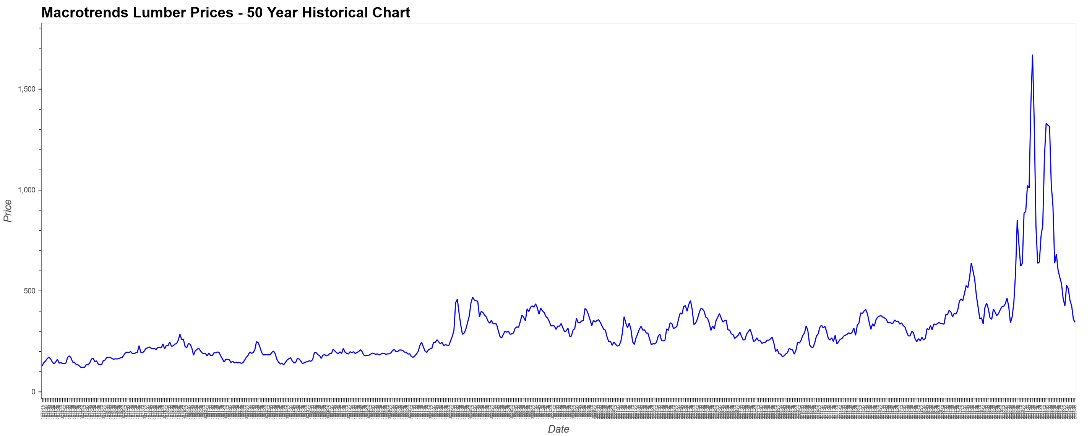
Independent Variables
Macrotrends Lumber Prices - 50 Year Historical Chart
https://www.macrotrends.net/2637/lumber-prices-historical-chart-data

Slide 7
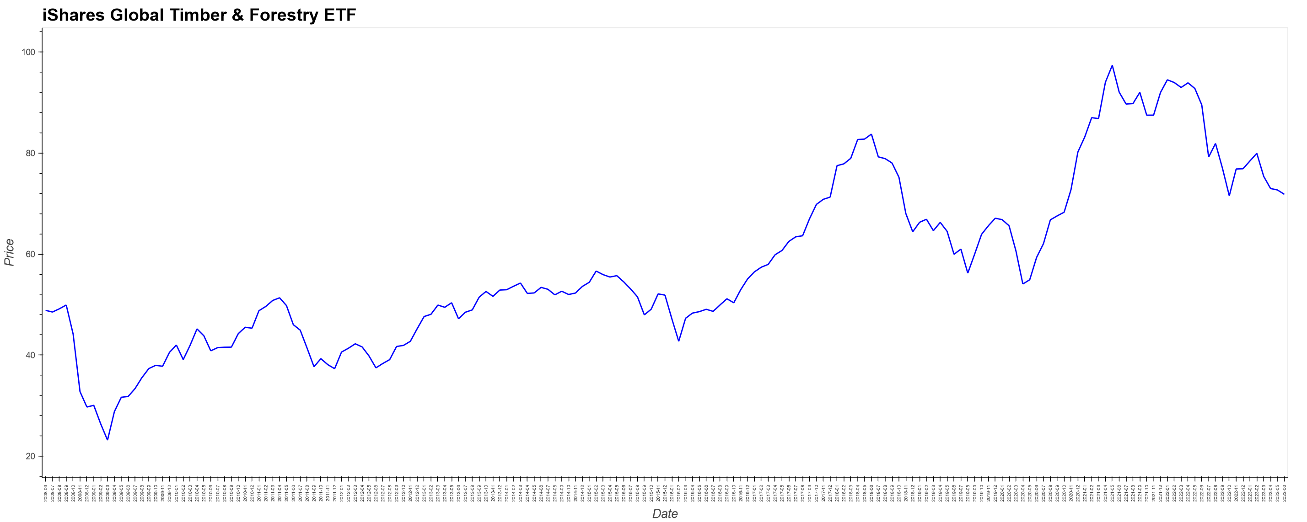
Independent Variables
iShares Global Timber & Forestry ETF (WOOD-Q)
https://finance.yahoo.com/quote/WOOD/history?p=WOOD

Slide 8
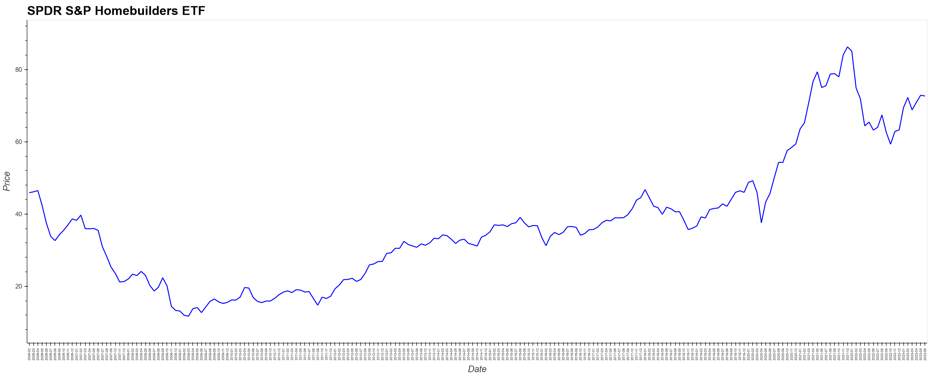
Independent Variables
SPDR S&P Homebuilders ETF (XHB)
https://finance.yahoo.com/quote/XHB/history?p=XHB

Slide 9
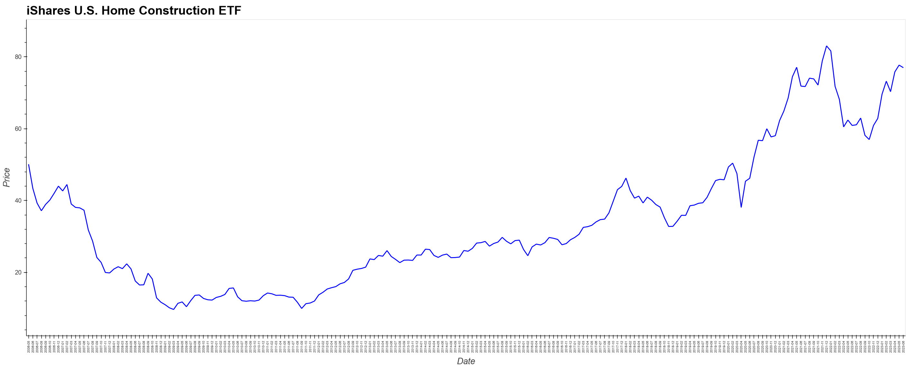
Independent Variables
iShares U.S. Home Construction ETF (IBT)
https://finance.yahoo.com/quote/ITB/history?p=ITB

Slide 10
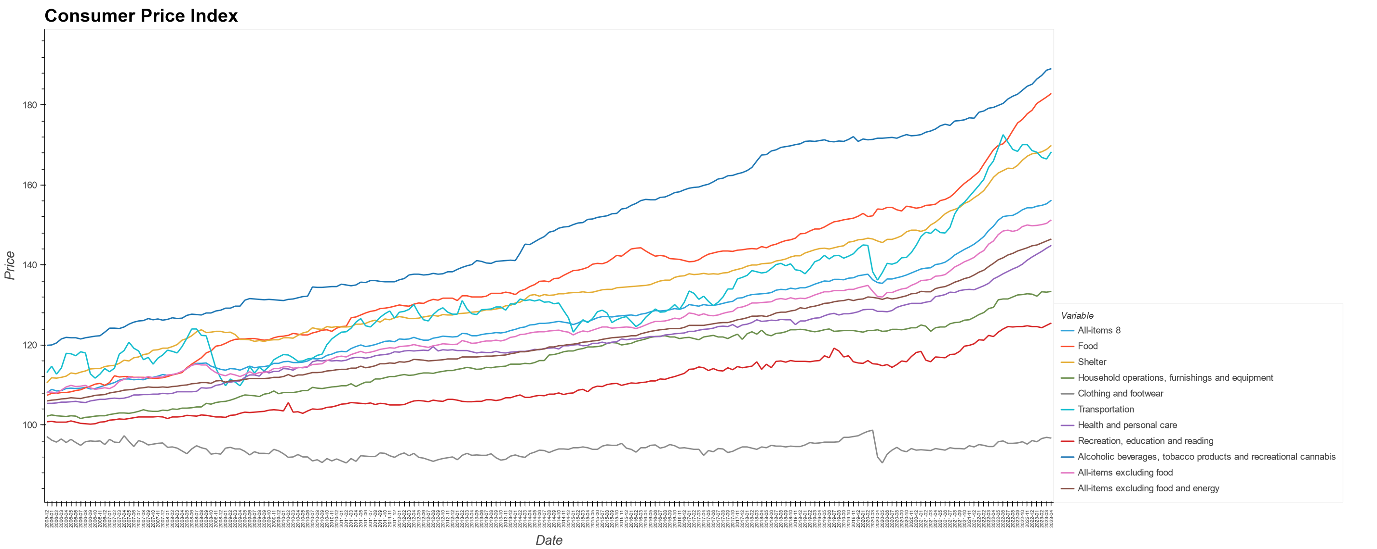
Independent Variables
Consumer Price Index (CPI)
https://www150.statcan.gc.ca/t1/tbl1/en/tv.action?pid=1810000601&cubeTimeFrame.startMonth=12&cubeTimeFrame.startYear=2005&cubeTimeFrame.endMonth=04&cubeTimeFrame.endYear=2023&referencePeriods=20051201%2C20230401

Slide 11
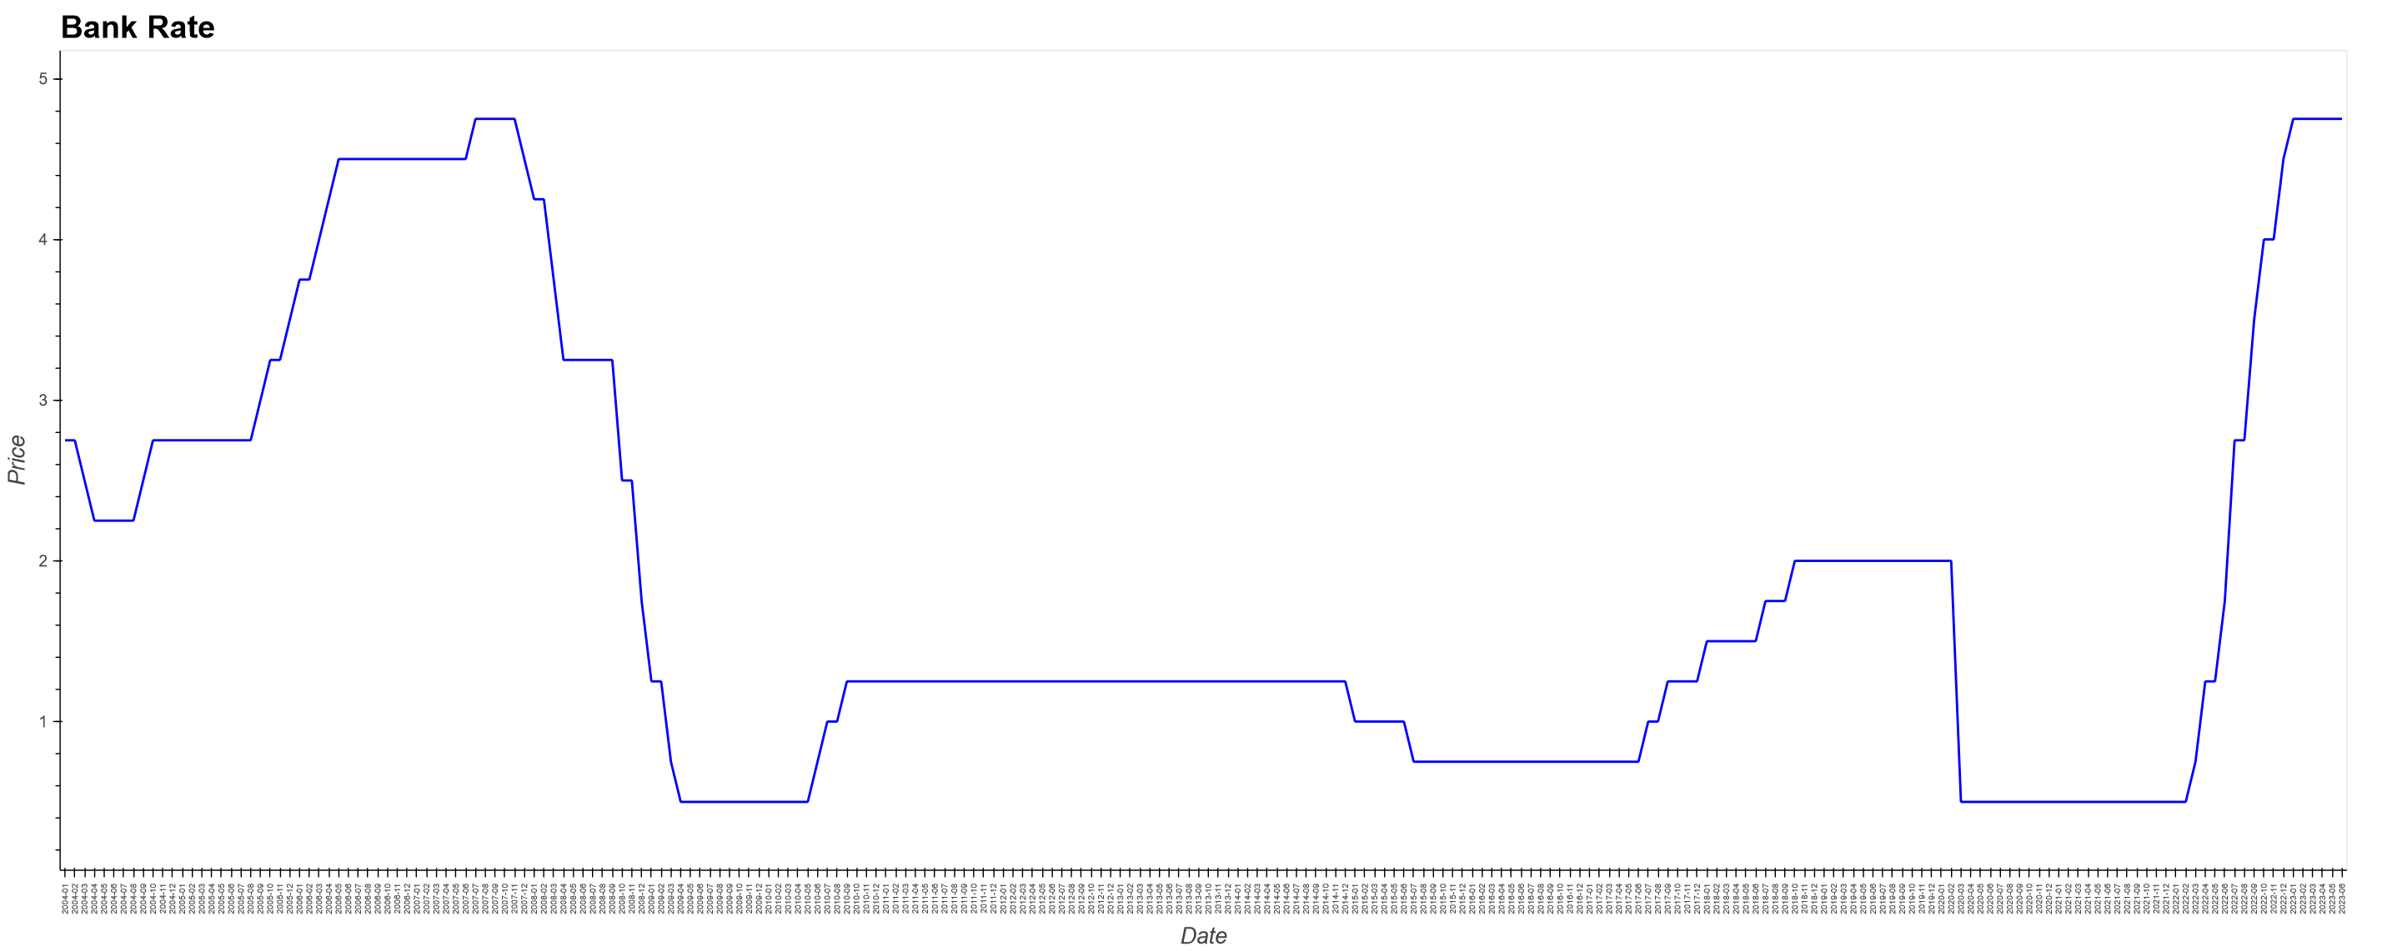
Independent Variables
Interest rates (Bank Rate)
https://www.bankofcanada.ca/rates/interest-rates/canadian-interest-rates/

Slide 12
Data Cleanup
Macrotrends Lumber Prices - 50 Year Historical Chart
iShares Global Timber & Forestry ETF (WOOD-Q)
SPDR S&P Homebuilders ETF (XHB)
iShares U.S. Home Construction ETF (IBT)
Data was business days, so we grouped by month using the mean value.
Consumer Price Index (CPI)
Data was monthly but need to be transposed.
Interest rates
Data was only when the rate changed. There could be multiple changes per month, so we needed to group by month using the last value. There was missing months where the rate hadn’t changed, so we needed to forward fill.

Slide 13
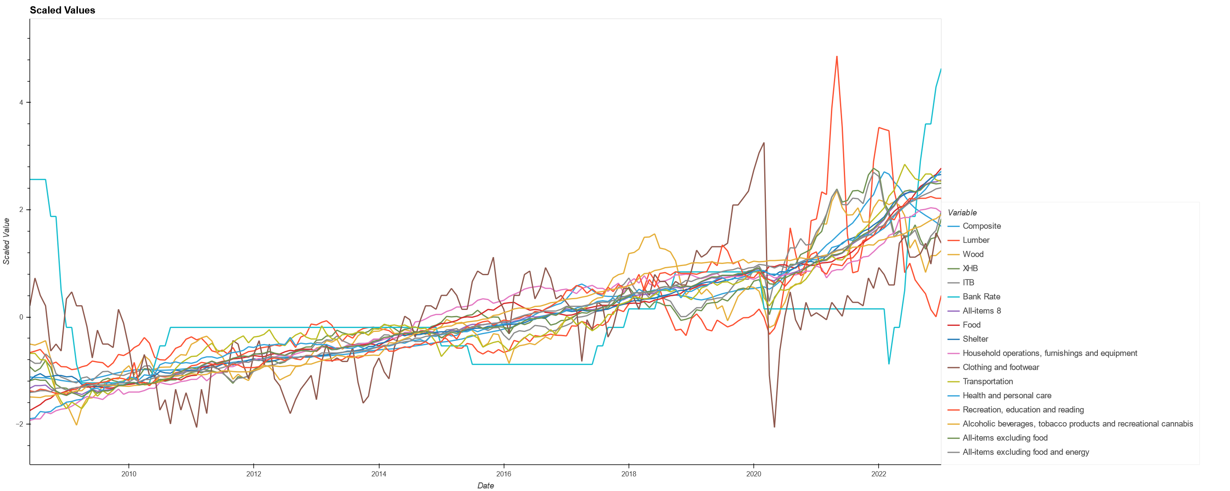
Scaled Values

Slide 14
Model #1 Summary
Model: "sequential" _________________________________________________________________ Layer (type) Output Shape Param # ================================================================= hidden1 (Dense) (None, 128) 2176 hidden2 (Dense) (None, 64) 8256 hidden3 (Dense) (None, 32) 2080 output (Dense) (None, 1) 33 ================================================================= Total params: 12,545 Trainable params: 12,545 Non-trainable params: 0

Slide 15
Model #1 Compile, Split, and Fit
Loss: mean_squared_error Optimizer: adam
Metrics: MeanSquaredError()
Train: 2008-06-01 to 2018-11-01 (126 months)
Test: 2018-12 to 2023-01 (51 months)
Batch Size: 10
Validation Split: 0.2
Epochs: 100

Slide 16
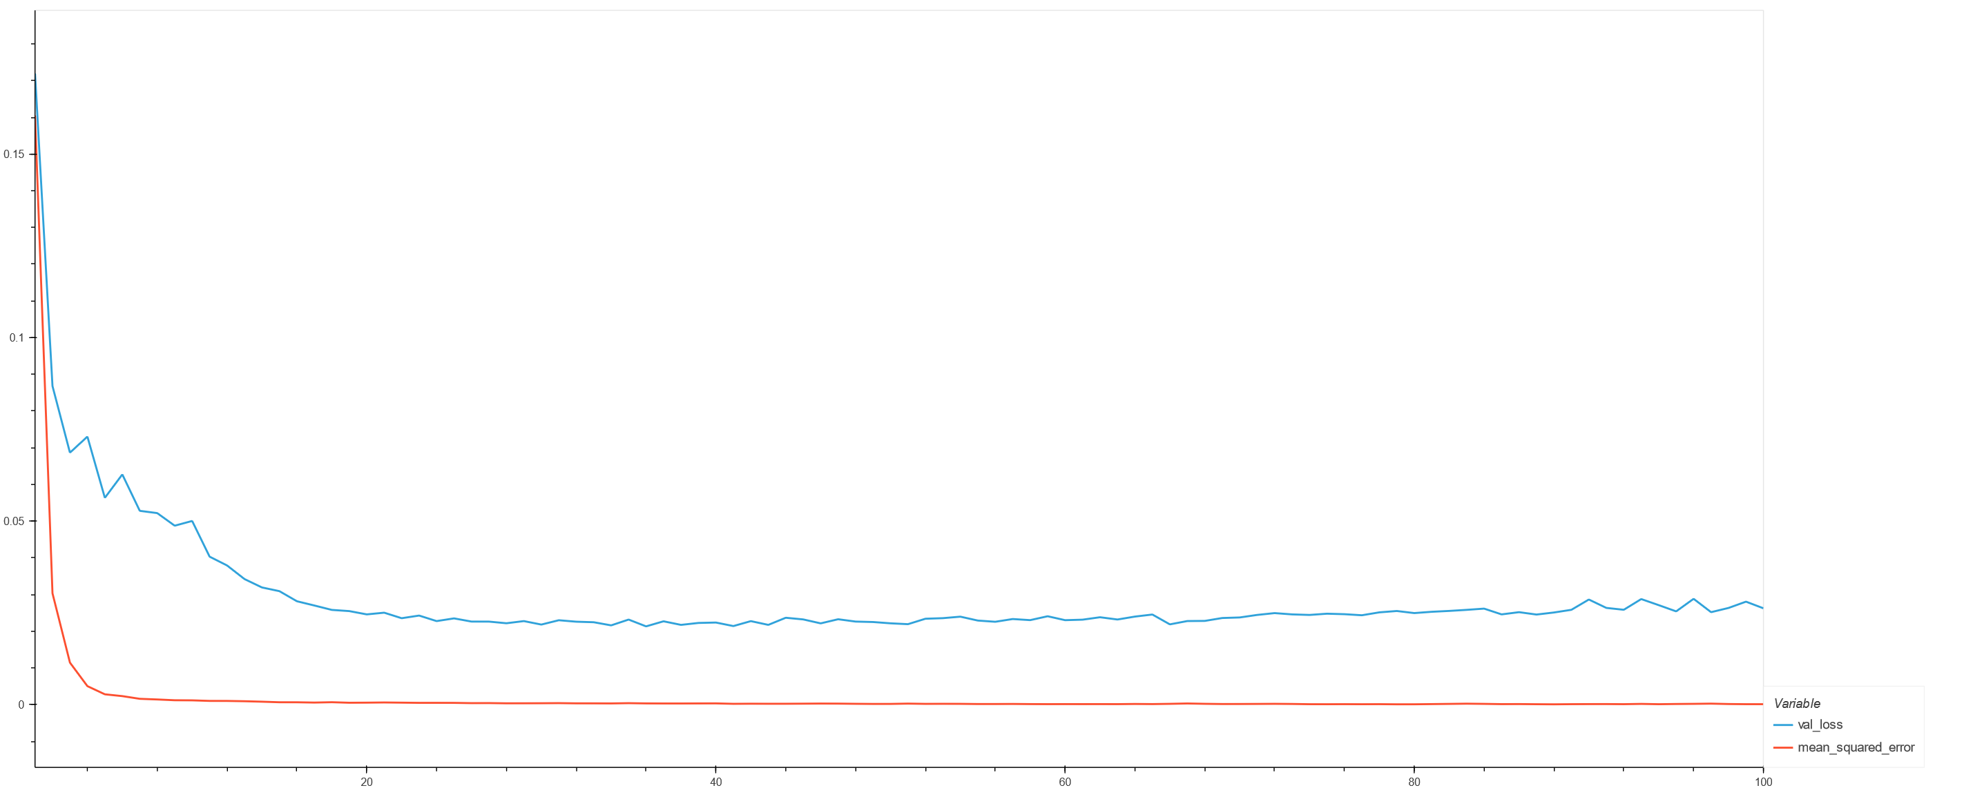
Model #1 Loss

Slide 17
Model #1 Evaluation Metrics
R-Squared (train): 0.9810348099168302
R-Squared (test): 0.7932797852562208
Mean Absolute Error: 0.2948221013030288
Mean Absolute Percentage Error: 104.1188465552453
Mean Squared Error: 0.12061060454605094
Root Mean Squared Error: 0.34729037496891696
Normalized Root Mean Squared Error: 0.14536707357190323
Weighted Absolute Percentage Error: 39.489782829815134
Weighted Mean Absolute Percentage Error: 23.778567482963275

Slide 18
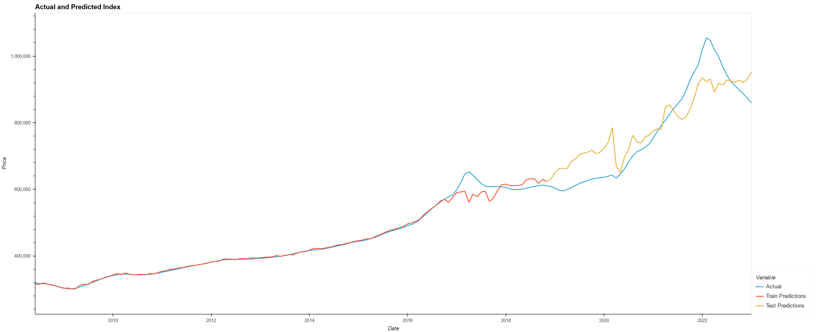
Model #1 Actual and Predicted Values
Housing Bubble
Covid

Slide 19
Model #2

Slide 20
Model Split
train_test_split
random_state=1
test_size = 0.25
train_size = 0.75

Slide 21
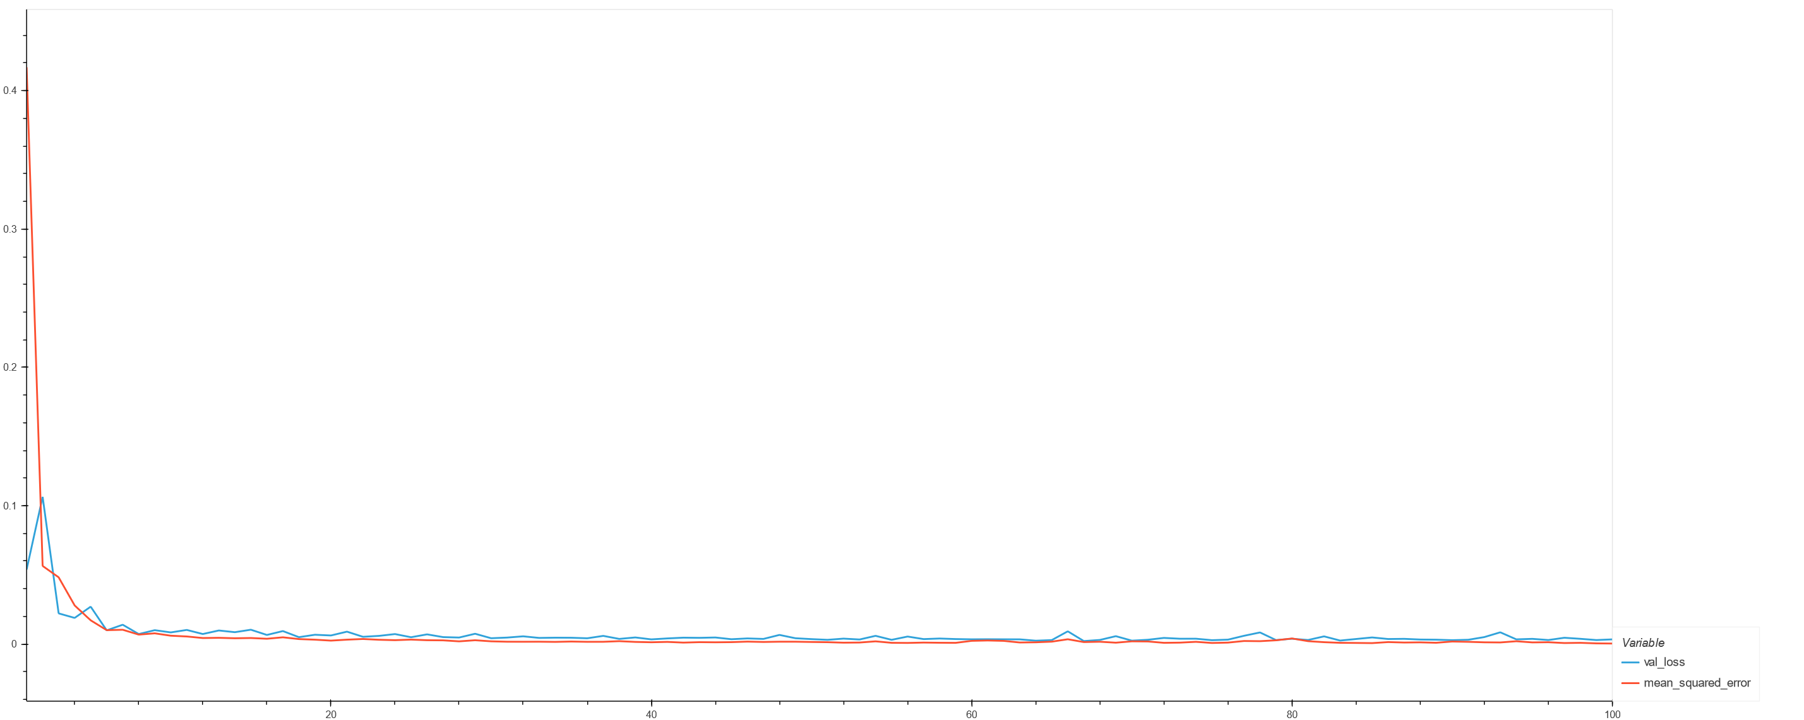
Model #2 Loss

Slide 22
Model #1 Metrics
Model #2 Metrics
R-Squared (train): 0.9810348099168302
R-Squared (test): 0.7932797852562208
Mean Absolute Error: 0.2948221013030288
Mean Absolute Percentage Error: 104.1188465552453
Mean Squared Error: 0.12061060454605094
Root Mean Squared Error: 0.34729037496891696
Normalized Root Mean Squared Error: 0.14536707357190323
Weighted Absolute Percentage Error: 39.489782829815134
Weighted Mean Absolute Percentage Error: 23.778567482963275
R-Squared (train): 0.9990344893913224
R-Squared (test): 0.9933129019432224
Mean Absolute Error: 0.04145187547962281
Mean Absolute Percentage Error: 172.07812243762567
Mean Squared Error: 0.0060022770830948065
Root Mean Squared Error: 0.07747436403801458
Normalized Root Mean Squared Error: 0.020876970132266803
Weighted Absolute Percentage Error: 5.91062216251355
Weighted Mean Absolute Percentage Error: -70.75257229306862

Slide 23
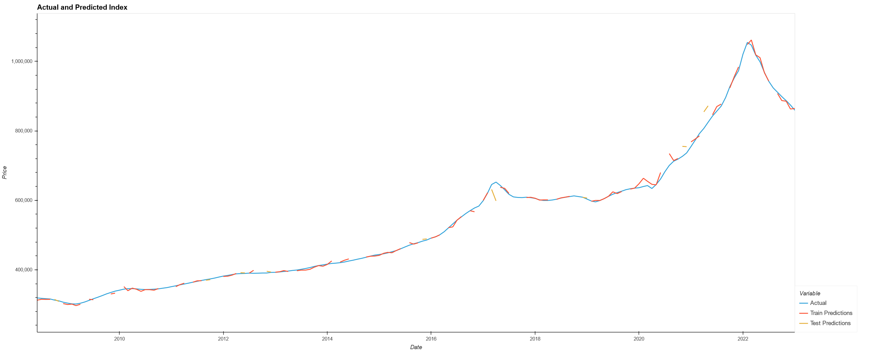
Model #2 Actual and Predicted Values
Housing Bubble
Covid

Slide 24
Model #3

Slide 25
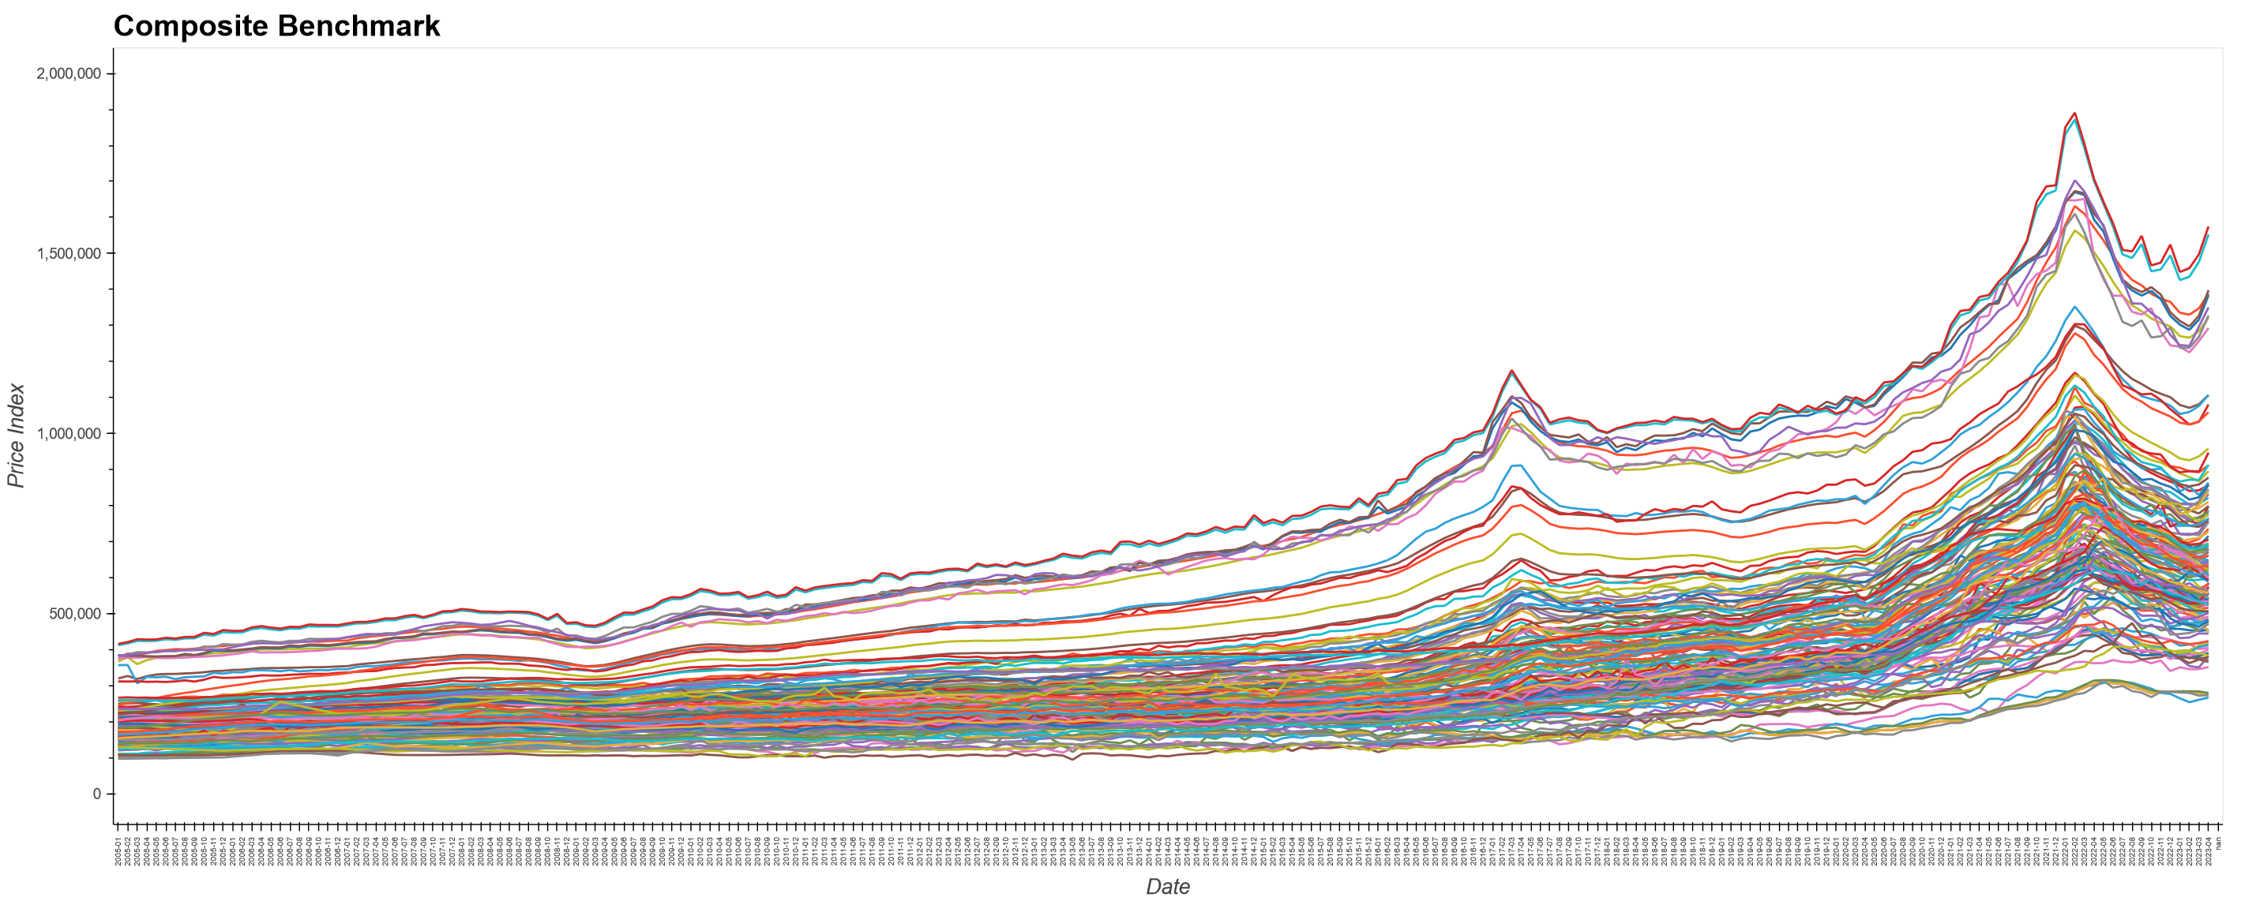
Dependent Variable
CREA – Composite Benchmark for Ontario
https://creastats.crea.ca/en-CA/
161 Columns – 29 regions

Slide 26
Loop Through Node Counts
prev_test_r2 = 0
nodes = [16, 32, 64, 128, 256, 512, 1024]
for node1 in nodes:
for node2 in nodes:
for node3 in nodes:
layer1 = node1
layer2 = node2
layer3 = node3
…
test_r2 = r2_score(y_test.values, predictions)
if test_r2 > prev_test_r2:
nn.save(Path(f"./Models/{layer1}_{layer2}_{layer3}_r2score{test_r2}.h5"))
prev_test_r2 = test_r2

Slide 27
Model #3 Summary
Model: "sequential"
_________________________________________________________________
Layer (type) Output Shape Param #
=================================================================
hidden1 (Dense) (None, 128) 1792
hidden2 (Dense) (None, 512) 66048
hidden3 (Dense) (None, 1024) 525312
output (Dense) (None, 161) 165025
=================================================================
Total params: 758,177
Trainable params: 758,177
Non-trainable params: 0
_________________________________________________________________

Slide 28
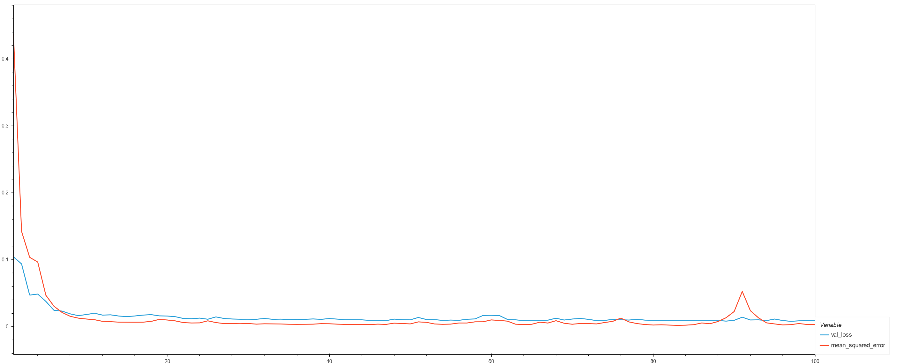
Model #3 Loss

Slide 29
Model #1 Metrics
Model #2 Metrics
R-Squared (train): 0.9810348099168302
R-Squared (test): 0.7932797852562208
Mean Absolute Error: 0.2948221013030288
Mean Absolute Percentage Error: 104.1188465552453
Mean Squared Error: 0.12061060454605094
Root Mean Squared Error: 0.34729037496891696
Normalized Root Mean Squared Error: 0.14536707357190323
Weighted Absolute Percentage Error: 39.489782829815134
Weighted Mean Absolute Percentage Error: 23.778567482963275
R-Squared (train): 0.9990344893913224
R-Squared (test): 0.9933129019432224
Mean Absolute Error: 0.04145187547962281
Mean Absolute Percentage Error: 172.07812243762567
Mean Squared Error: 0.0060022770830948065
Root Mean Squared Error: 0.07747436403801458
Normalized Root Mean Squared Error: 0.020876970132266803
Weighted Absolute Percentage Error: 5.91062216251355
Weighted Mean Absolute Percentage Error: -70.75257229306862
Model #3 Metrics
R-Squared (train): 0.9963811342292684
R-Squared (test): 0.9934014479377135
Mean Absolute Error: 0.05411884218805003
Mean Absolute Percentage Error: 15.966261460535296
Mean Squared Error: 0.007147470484226297
Root Mean Squared Error: 0.08454271396298026

Slide 30
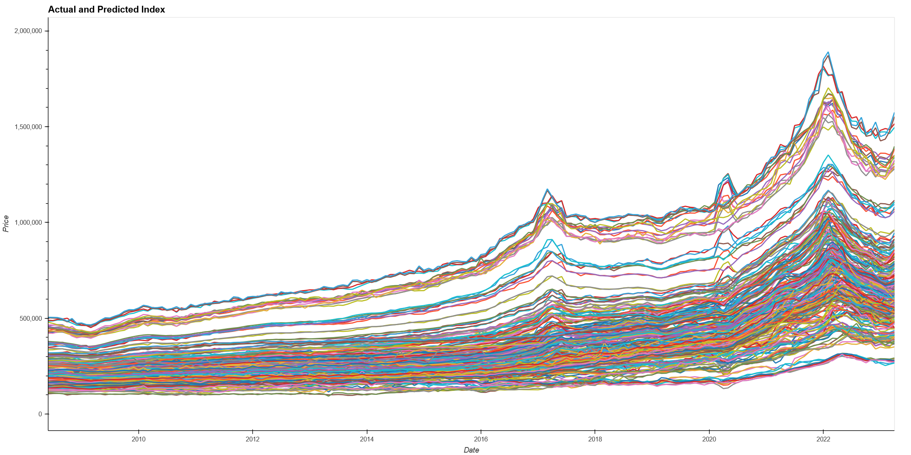
Model #3 Actual and Predicted Values

Slide 31
DEMO

Slide 32

THANK YOU

